Slide 1
Machine Stories: Machine Learning as Computerized Narrative Design
Stephen Paff

Slide 2
Machine Learning
Formal definition of Machine Learning:
“Learning denotes changes in the system that are adaptive in the sense that they enable the system to do the task or tasks drawn from the same population more efficiently and more effectively the next time” (Simon).
In short, machine learning refers to:
An algorithm which learns by developing its own way to analyze data (in the same or new context) through adapting over iterations

Slide 3
Shift in Relationship in Computer Science
Traditional Programming
Machine Learning
Requirements
Human
Program
Computer
Output
Data
Input
Requirements
Machine Learning (guidelines)
Program
Computer
Output
Data
Input
Human
Notes:
Assuming you know traditional programming, this is how machine learning differs from traditional programming. In traditional programming, you have access to the data, you will look at the data and transform it into knowledge that a computer can understand, namely a program. This model is not scalable for “Big data” or even “moderate data” because imagine how many smart analysts will you need and even if you have a smart analyst, he/she does not have enough brain power to parse through large amount of data. The beauty of machine learning is that it is more scalable. You feed it data and desired output and the machine learning algorithm will automatically output a program for you.
Another reason for preferring machine learning over traditional programming is that we are entering the era of Big data. There is a deluge of data which calls for automated methods of data analysis, which is what machine learning provides.

Slide 4
Thesis
Two Arguments:
We need to use emergence to understand machine learning systems
To do this, we must analyze machine learning algorithms as:
Social agents
Functioning within narrative structures

Slide 5
Argument 1:
We need to use emergence to understand machine learning systems.
Two types of emergence:
Weak: Machine learning algorithms are a low-level emergent entity
Complicated: The overall human-software systems in which they exist become have even greater potential for emergence

Slide 6
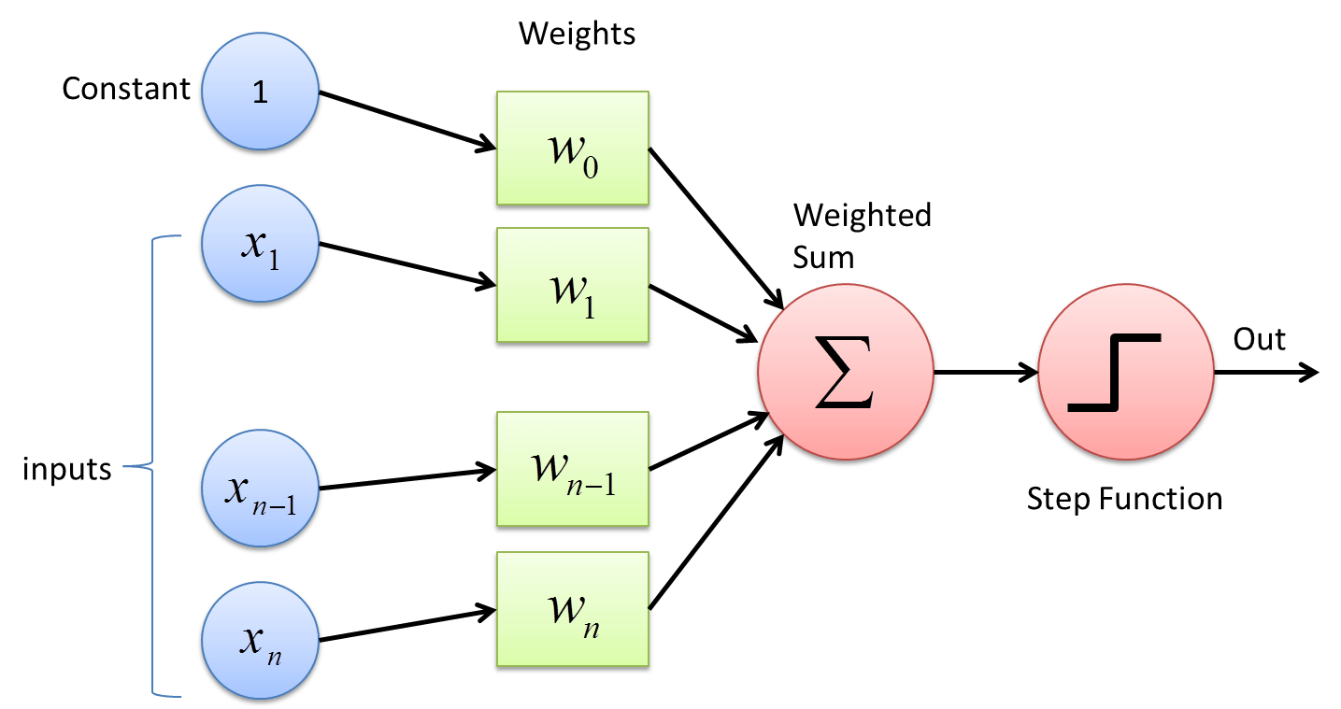
Iterating over Data
At the most basic level, machine learning algorithms:
Refine the parameters used to model the behavior
By iterating over data, tweaking the parameters
In order to improve accuracy
Through these, a model to analyze the data emerges.

Slide 7
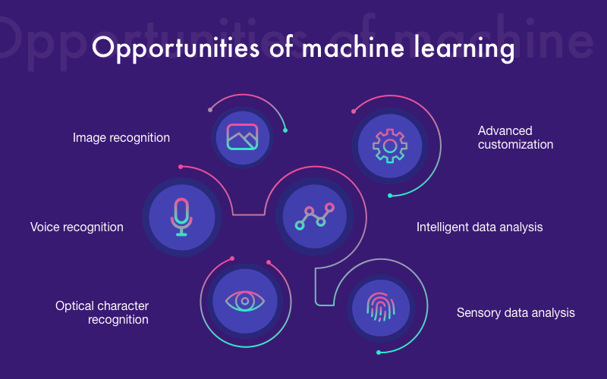
Emergent Software Systems
Machine learning algorithms are typically an important part of an overall system of different programs.
Through their interaction with other software systems and humans, more complicated structures emerge exhibiting even more complicated behavior.

Slide 8
Cybernetics and Machine Learning
Cybernetics is the best tool to conceptualize and facilitate the development of these emergent systems.
Machine learning involves adaptive relationships to build intelligence based on observations. Yet, they are an extremely weak version of this.

Slide 9
Argument 2:
To see them as emergent, we must understand machine learning algorithms as:
Social agents
Functioning within narrative structures

Slide 10
Social Agent Definition
Social: Interactive, interacts in a web of relationships with other entities (not just humans)
Agency: The ability to influence other entities
Thus a social agent interacts with other entities in a web of relationships, influencing them and being influenced in the process

Slide 11
Non-Human Agency
Within a constructionist framework, two broad examples of non-human agents:
Material things/entities (e.g. Latour’s actor-network theory, object-oriented ontology)
Social processes/structures (e.g. Foucault’s work)
But machine learning algorithms straddle both.
.

Slide 12
Narrative Structures
Structure: A process or set of rules – whether strict or fluid – which form a system
Narrative Structure: A structure which facilitates some kind of transformation for an agent(s) in the system overtime
Machine learning algorithms are themselves narrative structures.
The wider human-computer systems in which they exist are also narrative structures
These narrative structures are agents.

Slide 13
Conclusion:
In cybernetics, we need to use emergence to help computer scientists understand/develop machine learning systems.
This requires viewing these systems as social agents functioning within narrative structures.

Slide 14
Image Sources
The images are from the following sources (in order of usage in slides):
Slide taken from presentation by Deepak Venugopal, with my own minor modifications
https://towardsdatascience.com/what-the-hell-is-perceptron-626217814f53
https://www.cleveroad.com/blog/importance-of-machine-learning-applications-in-various
https://sociable.co/technology/5-facts-machine-learning-ai/

Slide 15
Bibliography:
For my Bibliography (in Google Drive), go to the following link:
https://bit.ly/2uBMlrD

