Slide 1
Anthropology by Data Science: The EPIC Project with Indicia Consulting as an Exploratory Case Study
By Stephen Paff

Slide 2
Introduction
Thesis: Anthropologists should, when applicable, conduct anthropology by science (that is, integrate data science techniques into ethnographic and other anthropological work)
I will use Nick Seaver’s concept of bastard methodology to ground this theoretically.
My practicum with Indicia Consulting is an exploratory case study in such integrative work.
Indicia Consulting “is a mission-driven social enterprise” that seeks to “increase in sustainability and subsequent improvement in the natural environment through engaging behavior through proven social science insights and methods” (EPIC 2018).
Outline:
Introduce key concepts
Discuss Nick Seaver’s concept of bastard methodology
Summarize our project
Analyze strengths and weaknesses of our project
Conclusion

Slide 3
Definitions
Data: Information (or things known) that form the basis of analysis
Data science: The science of analyzing data computationally.
Machine learning algorithms: Algorithms that “learn” by modifying themselves as they iterate through data
https://www.quora.com/What-is-the-difference-between-data-science-data-analysis-data-mining-machine-learning-AI-and-big-data

Slide 4
Interconnections
Data scientists study data through machine learning algorithms (primarily).
Just like:
Anthropologists study culture through ethnography (primarily).
Discipline | Who | What | How/Technique
Data Science | Data scientists | Data | Machine Learning
Anthropology | Anthropologists | Culture | Ethnography

Slide 5
Shift in Relationship in Computer Science
Traditional Programming
Machine Learning
Requirements
Human
Program
Computer
Output
Data
Input
Requirements
Machine Learning (parameters)
Program
Computer
Output
Data
Input
Human
Slide taken from lecture by Dr. Deepak Venugopal
Notes:
Assuming you know traditional programming, this is how machine learning differs from traditional programming. In traditional programming, you have access to the data, you will look at the data and transform it into knowledge that a computer can understand, namely a program. This model is not scalable for “Big data” or even “moderate data” because imagine how many smart analysts will you need and even if you have a smart analyst, he/she does not have enough brain power to parse through large amount of data. The beauty of machine learning is that it is more scalable. You feed it data and desired output and the machine learning algorithm will automatically output a program for you.
Another reason for preferring machine learning over traditional programming is that we are entering the era of Big data. There is a deluge of data which calls for automated methods of data analysis, which is what machine learning provides.

Slide 6
Anthropological Literature about Data Science
For anthropological theories about data science, I am most interested in the relationship they form with data science:
Relationship | Definition
Anthropology of Data Science | Anthropological analysis of data science and/or data scientists
Anthropology over Data Science | Perspectives that anthropology should oversee, regulate, or monitor data science work
Anthropology with Data Science | Collaborative work between the anthropology and data science
Anthropology by Data Science | Using data science tools to conduct anthropological work

Slide 7
Seaver’s Bastard Methodology
Bastard methodology: mishmash approach combining several disciplinary strategies/techniques based on what works to address a specific research question(s) or issue(s)
Data science techniques and ethnography are both bastard methodologies (2015:44-45).
I will call the opposite approach a purist disciplinary approach:
Separating one’s disciplinary methodology to ground its rigor
https://twitter.com/docurbs/status/1007375834347376642

Slide 8
Seaver’s Bastard Methodology
“These relationships between methods are, by now, such disciplinary common sense that we might be surprised how much work goes into rehearsing and reinforcing them. Either ethnography and formal analysis compete for jurisdiction over concepts like ‘culture,’ or they enter into scripted collaborations with each other, drawing on their apparently complementary strengths. Often, these arguments about how big data and ethnography might get along rehearse claims that have defined ethnography and its relationship to other methods throughout ethnography's entire history.” (2015:37)
“Data scientists work as professional bastard-makers, combining data sets, algorithms, and epistemologies in unauthorized ways to produce illicit offspring” (43).
“Ethnography is a bastard too, breeding descriptions from illicit encounters, mixing conceptual schemes, and stirring the blood of experience with the ink of theory. As we examine the family situation of bastard algebra [data science], we will have to come to terms with the bastard status of ethnography itself, remaining open to the ubiquity and generative potential of epistemologies that overflow their borders and relate without permission” (44-45).

Slide 9
Anthropology with Data Science
Collaborative
Separate but complementary
Combine at the level of people: specialists/people work together
Action: Seek to work collaboratively data scientists, advancing the value of our “part” of that work
Anthropology by Data Science
Integrative
Entangles the two through cross-pollination
Combine at the level of practice: make adjustments to our practice
Action: Incorporate data science techniques into our ethnographic toolkit as a way to cross-pollinate

Slide 10
Project History
My practicum focused on Task 6 of the EPIC Project.
Task | Timeline | Task Name | Research Technique | Description
Task 1 | June 2015-Sept 2018 | General Project Tasks | Administrative (N/A) | Developed project scope and timeline, adjusting as the project unfolds
Task 2 | July 2015 – July 2016 | Documenting and analyzing emerging attitudes, emotions, experiences, habits, and practices around technology adoption | Survey | Conducted survey research to observe patterns of attitudes and behaviors among cybersensitives/awares.
Task 3 | Sept 2016 – Dec 2016 | Identifying the attributes and characteristics and psychological drivers of cybersensitives | Interviews and Participant-Observation | Conducted in-depth interviews and observations coding for psych factor, energy consumption attitudes and behaviors, and technological device purchasing/usage.
Task 4* | Sept 2016 – July 2017 | Assessing cybersensitives' valence with technology | Statistical Analysis | Tested for statistically significant differences in demographics, behaviors, and beliefs/attitudes between cyber status groups
Task 5 | Aug 2017 – Dec 2018 | Developing critical insights for supporting residential engagement in energy efficient behaviors | Statistical Analysis | Analyzed utility data patterns of study participants, comparing it with the general population.
Task 6 | March 2018 – Aug 2018 | Recommending an alternative energy efficiency potential model | Decision Tree Modeling | Constructed decision tree models to classify an individual’s cyber status
*I originally joined the project in March 2017 to complete Task 4.

Slide 11
Task 6 Project Goal
Task 6’s goal was to use decision tree modeling to represent people’s cyber status.

Slide 12
Cyber Status
Cyber status: psychosocial characteristics Indicia developed in this project to understand an individual’s perceived emotional (or lack of) connection with technology and resulting behaviors (Indicia Consulting 2018:5)
Made up of 5 ranked groups:
Cybersensitive
Cyberaware
Mainstream
Low Mainstream
Null

Slide 13
Decision Tree Modeling
Decision trees generally model a decision-making flow through a hierarchy of (usually) binary Boolean decisions or criteria, such as true/false or yes/no conditions (Paff 2018:24; Indicia Consulting 2018:6).
Two types of decision trees:
Ethnographic decision tree modeling (EDTM)
Machine learning decision tree modeling (CART)
Both are abductive/iterative.
https://medium.com/@SeattleDataGuy/what-is-a-decision-tree-algorithm-4531749d2a17

Slide 14
Stages of EDTM
Interview: Conduct ethnographic interviews of one group about their decision-making process (Task 3)
Analyze: Review responses and organize into decision flow
Iterate: Run these set of choices past another similar group and modify accordingly (Gladwin 1997; Indicia Consulting 2018:11-12)
I was not the primary lead on the EDTM for this project.
https://www.amazon.com/Ethnographic-Decision-Modeling-Qualitative-Research/dp/0803934874

Slide 16
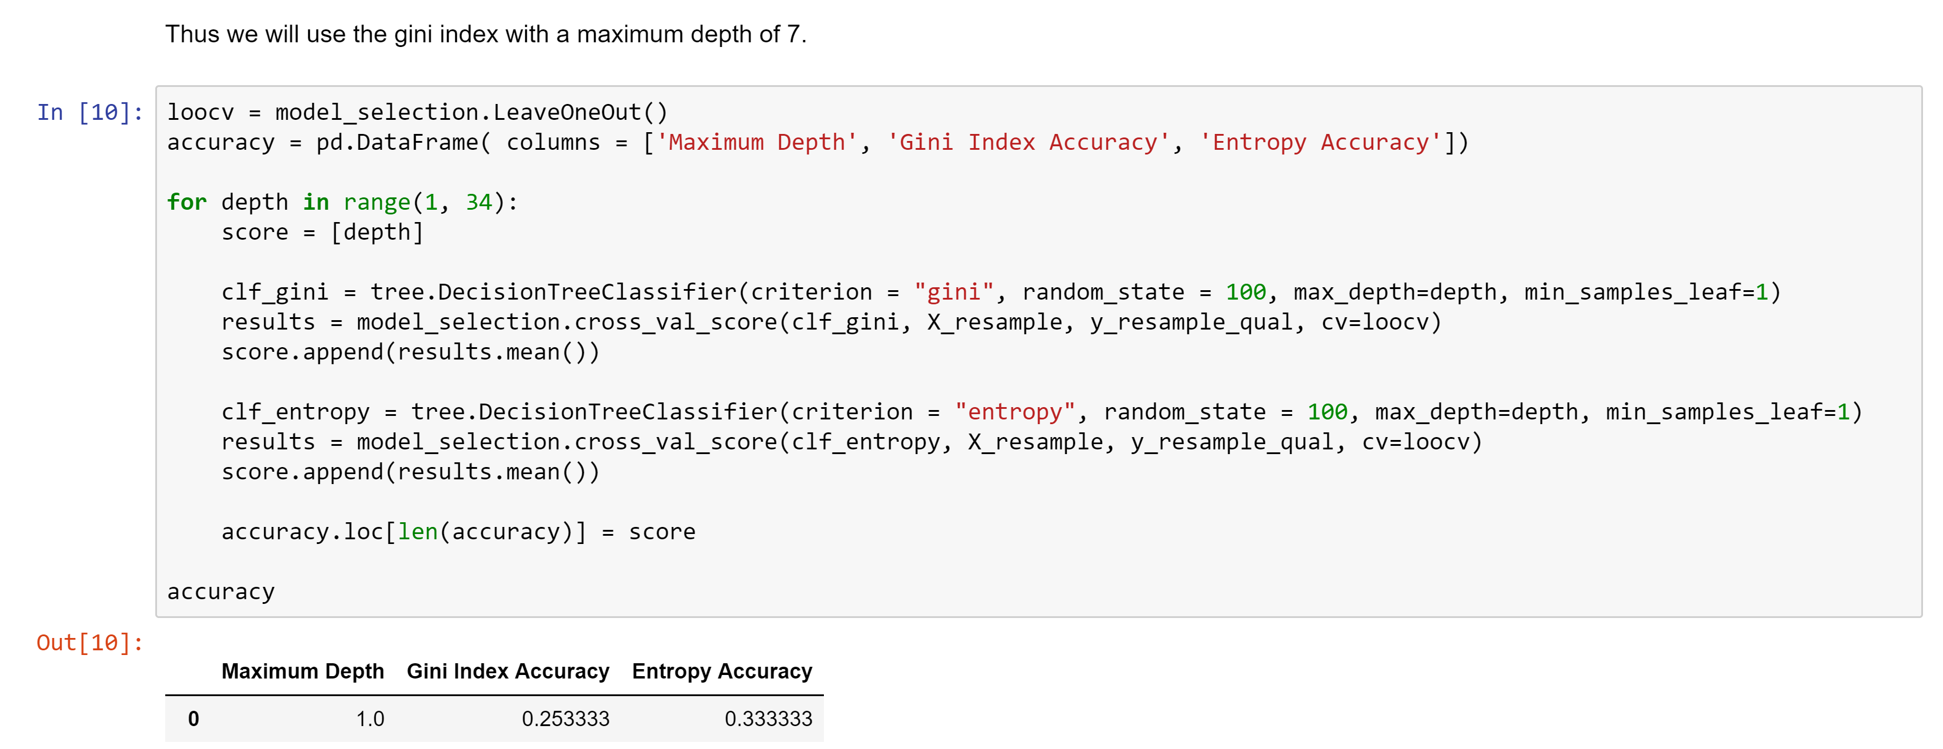
Stages of CART
Pre-Development: Cleaned and prepared data
Resampling
Development: Developed the decision tree model
Gini Index
Pruning: Tested the model’s accuracy and further refined by adjusting the (hyper)parameters and ensemble methods
Leave-One-Out Cross-Validation
Random Forests
Our random forest had 100% accuracy on our sample.

Slide 18
Project Strengths
Our decision tree models had the following strengths:
Intelligible narratives for both humans and computers
Intermixable parts, allowing for unique connections
Translatable:
Between disciplines
Into actionable insights for policy-makers
http://www.invistaperforms.org/strengths-key-higher-productivity-effectiveness-employee-engagement-joy/

Slide 19
Project Weaknesses
Unable to test against an external dataset
Potential for overfitting (representing features specific to the group studied)
Models developed separately to be integrated in testing
https://www.potentash.com/2018/02/20/important-embrace-your-weaknesses-lifestyle/

Slide 20
Strategy to Address Weaknesses
We obtained a second, external dataset of Prince Williams County for testing from Network Dynamics Simulation Science Laboratory at Virginia Tech University.
Ultimate Goals:
To create a general criteria to classify the cyber status of individuals in a whole population
To segment market specific energy-saving campaigns towards each group
https://www.marketingtechnews.net/news/2015/aug/21/big-data-and-personalisation-truly-comes-age-next-steps-cmo/

Slide 21
Conclusion
Nick Seaver’s concept of bastard methodology/disciplines helps ground a cross-pollinating approach between the anthropology and data science,
Within anthropology, this manifests as anthropology by data science work: using data science techniques in ethnographies when applicable.
Decision tree modeling is helpful for this.
The project is a exploration in anthropology by data science.

Slide 22
Work Cited
EPIC. Indicia Consulting. 2018. <https://www.epicpeople.org/business-directory/4430/indicia-consulting/>.
Gladwin, Christina H. Ethnographic Decision Tree Modeling. Newbury, CA: Sage, 1997.
Indicia Consulting. "Engaging Cybersensitives and Cyberawares in Energy Efficiency Part 1." Epic Project Task 6. 2018.
Paff, Stephen. Anthropology by Data Science: The EPIC Project with Indicia Consulting as an Exploratory Case Study. Practicum Report. Memphis: University of Memphis, 2018.
Seaver, Nick. "Bastard Algebra." Boellstorff, Tom and Bill Maurer. Data, Now Bigger and Better. Chicago: Prickly Paradigm Press, 2015. 27-46.

