Slide 1
Anthropology by Data Science: The EPIC Project with Indicia Consulting as an Exploratory Case Study
By Stephen Paff

Slide 2
Introduction
Thesis: We should seek ways to integrate ethnographic and data science techniques to solve real-world problems.
I will use my master’s practicum with Indicia Consulting as a way to explore how to do this.
Indicia Consulting “is a mission-driven social enterprise” that seeks to “increase in sustainability and subsequent improvement in the natural environment through engaging behavior through proven social science insights and methods” (EPIC 2018).

Slide 3
Ethnography
I define research as ethnographic when it seeks to holistically understand and express the lived experiences of actors in a social/cultural context(s) (Curran 2013; Edirisingha 2016).
Both ethnography and data science typically have the following in common, at least in many business contexts (Curran 2013):
Both are interested in the everyday culture.
Both explore patterns, movement, and networks.
Both are interested in the physical – how the body interacts with products and space.
Both attempt to understand in relation to consumption and life.
Both can offer holistic approaches to analysis.
http://hummedia.manchester.ac.uk/institutes/methods-manchester/docs/ethnographyinsociology.pdf

Slide 4
Seaver’s Bastard Methodology
Bastard methodology: mishmash approach combining several disciplinary strategies/techniques based on what works to address a specific research problem(s)
Data science and ethnographic methods are both bastard methodologies (2015:44-45).
I will call the opposite approach a purist disciplinary approach:
Separating one’s disciplinary methodology to ground its rigor
https://twitter.com/docurbs/status/1007375834347376642

Slide 5
Project History
My practicum focused on Task 6 of the EPIC Project.
Task | Timeline | Task Name | Research Technique | Description
Task 1 | June 2015-Sept 2018 | General Project Tasks | Administrative (N/A) | Developed project scope and timeline, adjusting as the project unfolds
Task 2 | July 2015 – July 2016 | Documenting and analyzing emerging attitudes, emotions, experiences, habits, and practices around technology adoption | Survey | Conducted survey research to observe patterns of attitudes and behaviors among cybersensitives/awares.
Task 3 | Sept 2016 – Dec 2016 | Identifying the attributes and characteristics and psychological drivers of cybersensitives | Interviews and Participant-Observation | Conducted in-depth interviews and observations coding for psych factor, energy consumption attitudes and behaviors, and technological device purchasing/usage.
Task 4* | Sept 2016 – July 2017 | Assessing cybersensitives' valence with technology | Statistical Analysis | Tested for statistically significant differences in demographics, behaviors, and beliefs/attitudes between cyber status groups
Task 5 | Aug 2017 – Dec 2018 | Developing critical insights for supporting residential engagement in energy efficient behaviors | Statistical Analysis | Analyzed utility data patterns of study participants, comparing it with the general population.
Task 6** | March 2018 – Aug 2018 | Recommending an alternative energy efficiency potential model | Decision Tree Modeling | Constructed decision tree models to classify an individual’s cyber status
*I originally joined the project in March 2017 to complete Task 4.
** My practicum was specifically Task 6.

Slide 6
Task 6 Project Goal
Task 6’s goal was to use decision tree modeling to represent people’s cyber status.

Slide 7
Cyber Status
Cyber status: psychosocial characteristics Indicia developed in this project to understand an individual’s perceived emotional (or lack of) connection with technology and resulting behaviors (Indicia Consulting 2018:5)
Made up of 5 ranked groups:
Cybersensitive
Cyberaware
Mainstream
Low Mainstream
Null

Slide 8
Decision Tree Modeling
Two types of decision trees:
Ethnographic decision tree modeling (EDTM)
Machine learning decision tree modeling (CART)
https://medium.com/@SeattleDataGuy/what-is-a-decision-tree-algorithm-4531749d2a17

Slide 9
Stages of EDTM
Interview: Conduct ethnographic interviews of one group about their decision-making process (Task 3)
Analyze: Review responses and organize into decision flow
Iterate: Run these set of choices past another similar group and modify accordingly (Gladwin 1997; Indicia Consulting 2018:11-12)
I was not the primary lead on the EDTM for this project.
https://www.amazon.com/Ethnographic-Decision-Modeling-Qualitative-Research/dp/0803934874

Slide 11
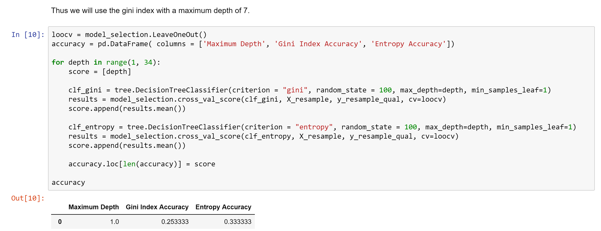
Stages of CART
Pre-Development: Cleaned and prepared data
Resampling
Development: Developed the decision tree model
Gini Index
Pruning: Tested the model’s accuracy and further refined by adjusting the (hyper)parameters and ensemble methods
Leave-One-Out Cross-Validation
Random Forests

Slide 13
Project Strengths
Our decision tree models had the following strengths:
Intelligible narratives for both humans and computers
Intermixable parts, allowing for unique connections
Translatable:
Between disciplines
Into actionable insights for policy-makers
http://www.invistaperforms.org/strengths-key-higher-productivity-effectiveness-employee-engagement-joy/

Slide 14
Project Weaknesses
Unable to test against an external dataset
Potential for overfitting
Models developed separately to be integrated in testing
https://www.potentash.com/2018/02/20/important-embrace-your-weaknesses-lifestyle/

Slide 15
Strategy to Address Weaknesses
We obtained a second, external dataset of Prince Williams County for testing from Network Dynamics Simulation Science Laboratory at Virginia Tech University.
Ultimate Goals:
To create a general criteria to classify the cyber status of individuals in a whole population
To segment market specific energy-saving campaigns towards each group
https://www.marketingtechnews.net/news/2015/aug/21/big-data-and-personalisation-truly-comes-age-next-steps-cmo/

Slide 16
Conclusion
Nick Seaver’s concept of bastard methodology helps ground a cross-pollinating approach between the anthropology and data science,
Decision tree modeling is helpful for this.
The project is a exploration in integrating ethnographic and data science techniques.

Slide 17
References
Curran, John. "Big Data or ‘Big Ethnographic Data’? Positioning Big Data within the Ethnographic Space." EPIC (2013).
Edirisingha, Prabash. Ethnography, lived experience and consumer research. 23 August 2016. <https://prabash78.wordpress.com/2016/08/23/ethnography-lived-experience-and-consumer-research/>.
EPIC. Indicia Consulting. 2018. <https://www.epicpeople.org/business-directory/4430/indicia-consulting/>.
Gladwin, Christina H. Ethnographic Decision Tree Modeling. Newbury, CA: Sage, 1997.
Indicia Consulting. "Engaging Cybersensitives and Cyberawares in Energy Efficiency Part 1." Epic Project Task 6. 2018.
Paff, Stephen. Anthropology by Data Science: The EPIC Project with Indicia Consulting as an Exploratory Case Study. Practicum Report. Memphis: University of Memphis, 2018.
Seaver, Nick. "Bastard Algebra." Boellstorff, Tom and Bill Maurer. Data, Now Bigger and Better. Chicago: Prickly Paradigm Press, 2015. 27-46.

