Slide 1
Breaking Into Tech
A Career Workshop

Slide 2
Agenda & Schedule
12:00 - 12: 15: Value Proposition & Introductions
12:15 - 12:30: What & Why Tech
12:30 - 1:00: Working in Tech
1:00 - 1:30: Transitioning to Tech
1:30 - 2:00: Breakout Sessions

Slide 3
Value Proposition & Intros

Slide 4
Audience & Value Proposition
Students
Context - Learn about the tech industry, roles, and responsibilities..
Guidance - How to position yourself to graduate with the knowledge and skills necessary to apply for a tech job.
Skills - How to write a resume and/or create a portfolio for tech.
Experience - Practice presenting yourself for tech.
Early to Mid-Career Anthros
Context - Learn about the tech industry, roles, and responsibilities..
Guidance - How to reframe your existing anthropology experience for a tech job.
Skills - How to write a resume and/or create a portfolio for tech.
Experience - Practice presenting yourself for tech.

Slide 5
Matt Artz
I am business and design anthropologist working in product management and UX.
Head of Product & Experience at Cloudshading Consulting.
Founder of Anthro to UX, a career coaching company helping anthropologists break into UX.
Adjunct Instructor of PM & UX in an MBA program.

Slide 6
Astrid Countee
I am a business anthropologist and technologist.
I am currently working as Chief of Staff at Cemvita Factory, a biotech company working with heavy industries to provide solutions for them to become carbon negative.
I am also a co-founder for Missing Link Studios. We distribute the podcast, This Anthro Life.

Slide 7
Stephen Paff
I am an anthropologist and data scientist/programmer.
I am currently a Senior Data Scientist at BiBerk. I have worked in multiple roles from data science to UX researcher.
I started EPIC Data Scientists + Ethnographers to organize business anthropologists and data scientists promote connections, collaborations, and integrations.
For more information about my work, feel free to check out my website: https://ethno-data.com/.

Slide 8
What & Why Tech?

Slide 9
First.. What Do We Mean by Tech?
Broadly speaking, information technology refers to electronics, software, and computers targeted at either businesses (B2B) or consumers (B2C).
We will be focused on the software portion of the sector in both B2B and B2C.

Slide 10
What Do We Mean by Software?
Consumer (B2C)
Mobile apps - Airbnb, Uber, Venmo
Desktop - Microsoft Office, Apple iWork, SPSS
Cloud - Microsoft Office 365, Google Docs,
Smart TV/Streaming - Media Apps like Netflix or Disney
Gaming - Consoles & handhelds
Business (B2B)
Mobile apps - Salesforce, Slack, Google Analytics
Desktop - Tableau, SAS,
Cloud - Adobe Creative Suite, MailChimp, JIRA

Slide 11
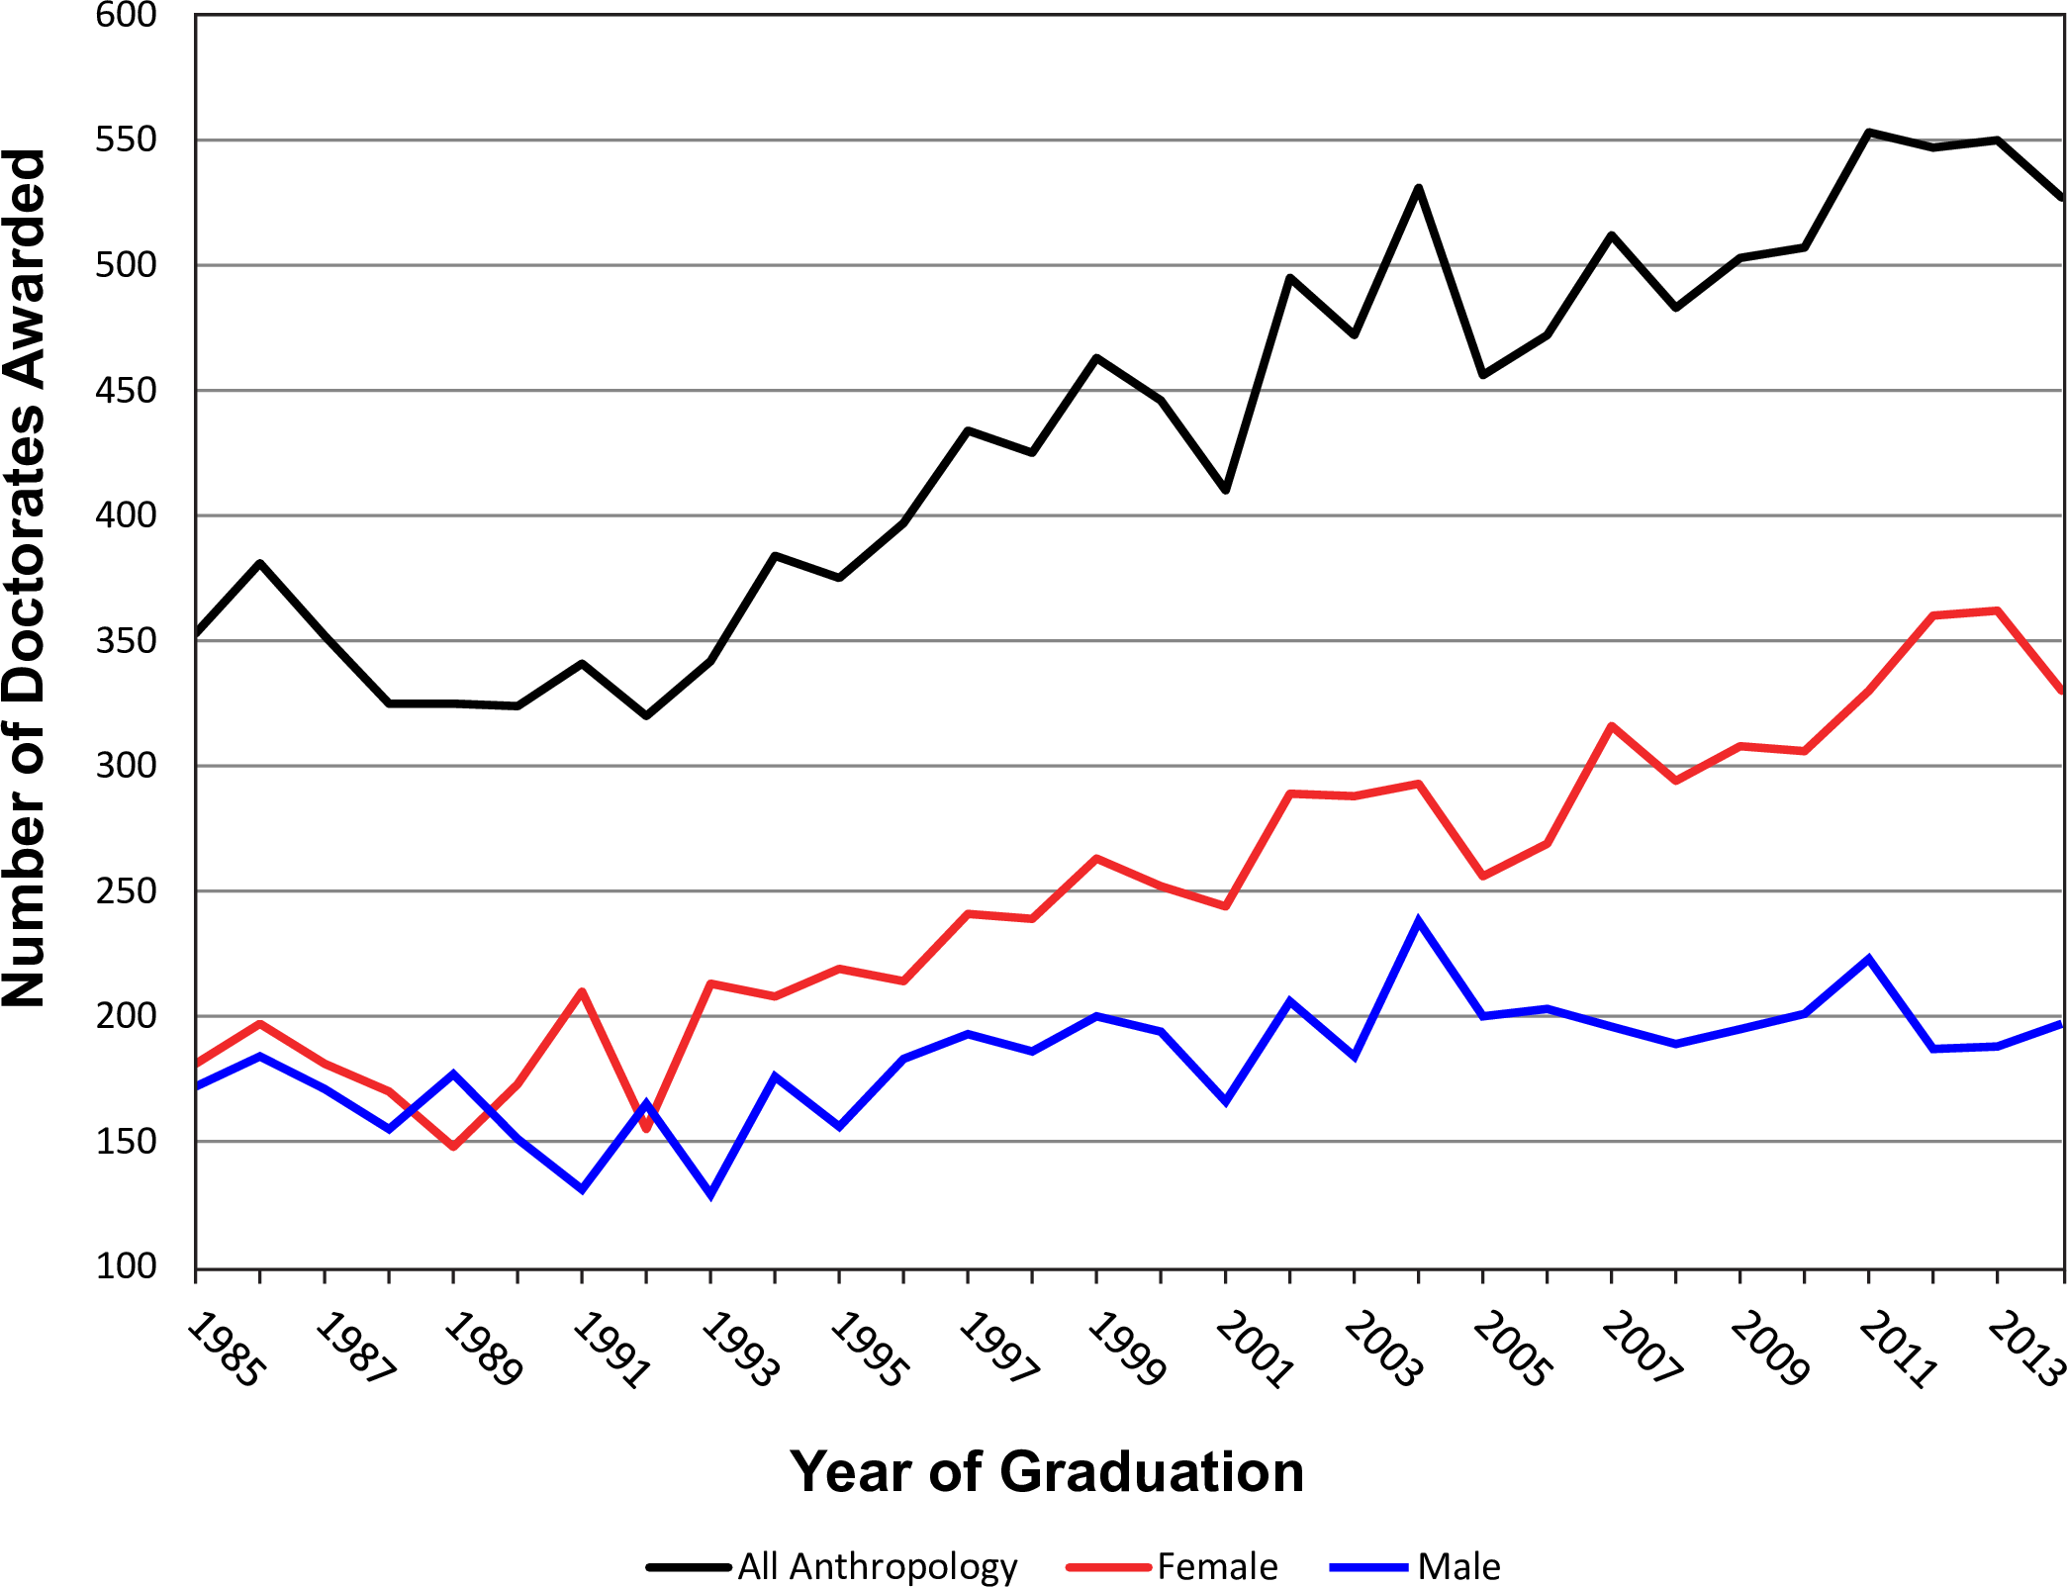
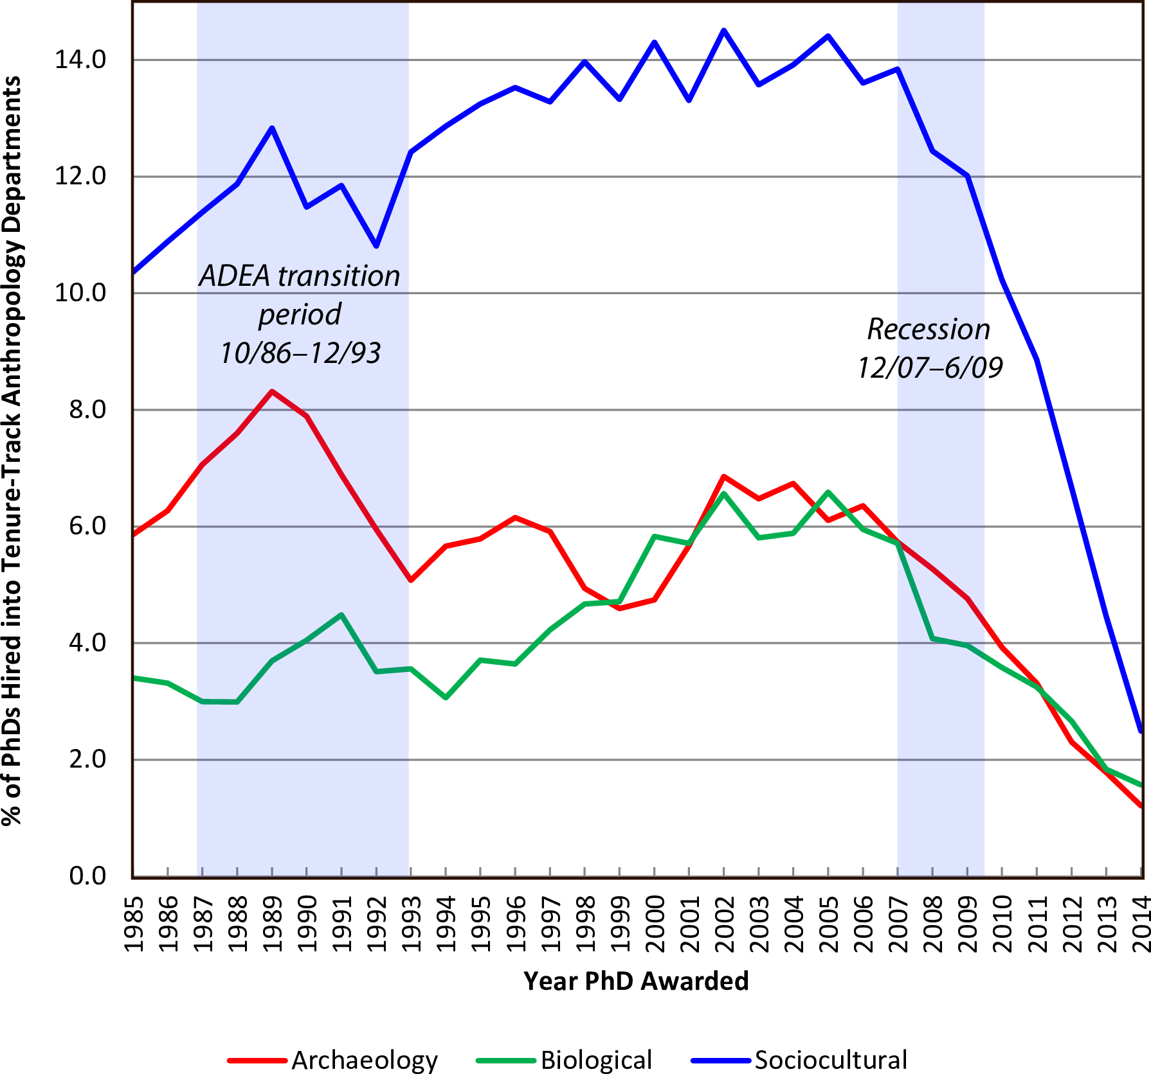
The State of Academic Anthropology
Speakman RJ, Hadden CS, Colvin MH, Cramb J, Jones KC, Jones TW, et al. (2018) Market share and recent hiring trends in anthropology faculty positions. PLoS ONE 13(9): e0202528. https://doi.org/10.1371/journal.pone.0202528

Slide 12
Meanwhile, in Tech...
Net tech employment grew by more than 307,000 workers in 2019 - an increase of 2.6% over 2018.
45 states and the District of Columbia expanded their tech workforce in 2019.
At $1.9 trillion, the tech sector accounts for an estimated 10% of the total U.S. economy, making it the third largest sector in the economy behind only manufacturing and government.
The tech industry's gross domestic product increased 66% between 2010 and 2019, adding $745.5 billion in output.
Source: CompTIA Cyberstates 2020™ report

Slide 13
4 Possible Roles in Tech (Our Roles)
UX Researcher - Responsible for conducting research to understand user behaviors, needs, and motivations. Also called user researcher.
Product Manager - Responsible for leading the product development process by coordinating all stakeholder activities.
Software Engineer - Responsible for writing the lines of code of software. May also include testing and architecture responsibilities.
Data Scientist - Responsible for conducting data analysis on large data sets, often requiring custom algorithms and predictive models.

Slide 14
Job Growth Stats by Role
UX Researcher Estimated 10-year job growth of 19% - CNN 100 Best Jobs 2017
Product Manager Estimated 10-year job growth of 15% - CNN 100 Best Jobs 2017
Software Engineer Estimated 10-year job growth of 13% - CNN 100 Best Jobs 2017
Data Scientists Estimated job growth of 15% from 2019 to 2029
-U.S. Bureau of Labor and Statistics

Slide 15
Salary Stats by Role
UX Researcher Median Pay: $106,000 Top Pay: $162,000 - CNN 100 Best Jobs 2017
Product Manager Median Pay: $103,000 Top Pay: $146,000 - CNN 100 Best Jobs 2017
Software Engineer Median Pay: $96,600 Top Pay: $146,000 - CNN 100 Best Jobs 2017
Data Scientists Median Pay: $ 122,840 Top Pay: $189,780+ -U.S. Bureau of Labor and Statistics 2019

Slide 16
Other Roles To Consider
Business analyst - work with organisations to help them improve their processes and systems.
Data analyst - collects, processes and performs statistical analyses on large dataset.
QA Engineering - is responsible for assessing the quality of specifications and technical design documents in order to ensure timely, relevant and meaningful feedback.
UX Strategist - work to ensure product-market fit. They often conduct research.
UX Designer - translate UX research into design artifacts. They may also conduct research.

Slide 17
Working In Tech

Slide 18
Role Considerations
Where are you in your career?
Are you a student looking for a first job? If yes, you will need to consider entry-level roles.
Junior UX Researcher / Product Owner / Junior UX Researcher / QA Tester / Data Analyst / Junior Data Scientist
If you early-to mid career you can likely enter above entry-level roles even though you are switching disciplines if you present your experience properly.
What skills do you currently have / what may you need to acquire?
Do you only have research skills? If so, then maybe UX Researcher is best.
But if you have tech, business, and/or leadership skills there may be other options?
What kind of work do you want to do?
Do you need to be a researcher, or are you happy applying the many strengths of anthropology to other roles?

Slide 19
Research Considerations
What type of research do you like?
Generative vs evaluative
What pace do you like to work at?
Business moves fast... much faster than academia.
What kind of impact do you want to have?
You may produce research which is not adopted and ends up as research debt.

Slide 20
Personal Considerations
Where do you want to live?
Some regions have sector strengths like finance/media/fashion in NYC or energy in Texas. Other regions like Silicon Valley have a broad range of sectors the tech industry supports.
Now, working from home has become trendy across the tech sector (increasing in the pandemic), not requiring a specific location to get a particular job, but living in key tech sectors is still really beneficial.
What type of product would you feel comfortable contributing to?
Do you want to work on a social issue, or are you ok with any type of product/service?
Work/Life balance
Tech jobs tend to have more flexibility than other industries and promote flexible work schedules, working remotely and distributed teams.
What do you want to learn?
Tech is a large industry and has many different types of companies with different focus. Do you want to learn about artificial intelligence, social movements, urban planning?

Slide 21
Organizational Considerations
Do you like large, mid-size or smaller companies?
No universal rule, but work culture, benefits, mentorship, advancement opportunities, and other aspects of the role can be impacted by the size.
Do you prefer a lot of processes or more free reign?
No universal rule, but roles at mid and large companies tend to be highly defined/specialized, and roles at small companies tend to involve wearing multiple hats.
Short-Term vs Long-Term Projects:
Do you like the “adventure” of exploring several projects or spending several years seeing one major project come to fruition (or something in between)?
What kind of work culture are you looking for?
Wall St. tech of NYC is not like Google of Mountain View.

Slide 22
Business Model Considerations
What type of business model would you be a fit for?
Product Companies
Focus - Building products or services to be sold to end users (B2B or B2C).
Performance - You are gauged on your output or contribution to internal projects.
Revenue Generation - Selling products/services (software).
Consulting Companies
Focus - Selling professional services such as software design & dev (B2B).
Performance - You are gauged on your performance delivering services and billable hours.
Revenue Generation - Selling professional services.

Slide 23
Typical Responsibilities of a UX Researcher
Communication
Emails... lots of emails
Chatting on some chat app such as Slack, Google Hangouts, or MS Teams
Participating in team meetings
Research
Planning research projects (time/cost)
Recruiting participants (internal/external)
Conducting research (qualitative & quantitative)
Analyzing the data (qualitative & quantitative)
Reviewing app analytics
Presenting the findings
Evalgenizing
Constantly reminding all team members about your finding to avoid research debt!

Slide 24
Typical Responsibilities of a Product Manager
Communication
Emails... lots of emails
Chatting on some chat app such as Slack, Google Hangouts, or MS Teams
Leading team meetings
Product Management
Defining product strategy & vision
Defining features and requirements
Building roadmaps / Managing backlog
Release management
Positioning and messaging
Evalgenizing
Making sure we are building the right product to solve customer problems.

Slide 25
Typical Responsibilities of a Software Engineer
Communication
Emails... lots of emails
Chatting on some chat app such as Slack, Google Hangouts, or MS Teams.
Participating in team meetings, standups
Software Engineering
Writing/reading code
Writing & conducting tests
Being comfortable learning new concepts
Teaching/Translating
Aiding other team members
Communicating to other business stakeholders
Problem Solving
Patience
Resourcefulness
Creativity

Slide 26
Typical Responsibilities of a Ops/Data Analyst
Communication
Emails... lots of emails
Chatting on some chat app such as Slack, Google Hangouts, or MS Teams.
Participating in team meetings, standups
Metrics/Analysis
Capturing metrics
Creating reports for business stakeholders
Providing meaningful analysis
Strategic Leadership
Aiding business decision making
Participating in leadership meetings
Project Management
Development of internal improvement projects
Mapping of data (Entity Relationship Diagrams)
Creativity

Slide 27
Typical Responsibilities of a Data Scientist
Communication
Technical Communication: Breaking down technical insights/findings for non-technical audiences to help determine the best way to move forward
Through written reports, formal presentations or information conversations/meetings, and everything in between
Working with a lot of people from a variety of backgrounds/expertises
In-person an online communications (emails, Slack, Teams, virtual meetings, etc.)
Programming Engineering
Data cleansing (The agonizing 90% of data science work)
Determining and building data science models
Writing reports and presenting/communicating findings
Evalgenizing
Helping others understand what machine learning models can and cannot
Helping to break down and determine what to do next for complex problems

Slide 28
Pros & Cons of UX Research
Pros
Overtly research oriented
Get to use the tools of anthropology to try and build products that will shape people’s lives
It’s rewarding to be conducting research
If part of a centralized research team, you will get to be around other researchers.
Cons
Often lacks influence compared to the product manager
Most co-workers won’t care about anthropological theories.
The depth of research may not meet your ideal standards.
If you are embedded in a product team, you may feel like a fish out of water.

Slide 29
Pros & Cons of Product Management
Pros
Have a high degree of influence
Get to use the tools of anthropology to try and build products that will shape people’s lives
It’s rewarding to to lead the process of creating products.
You get to be a culture broker.
Cons
May not be involved with research to a desirable degree.
You constantly have to make tradeoffs between teams, which means comprises have to be made.
You manage a process, not people, so it can be challenging.

Slide 30
Pros & Cons of Software Engineering
Pros
Direct influence in the creation of process or product
Abstract values can be made real
High valued member of the team
Stewardship of products that can have a direct impact on culture
Cons
Indirect use of the tools of anthropology (in junior roles)
Can be a competitive environment
Sometimes business requests trump engineering
Research oriented roles are rare in most businesses

Slide 31
Pros & Cons of Data Science
Pros
Very research-oriented
Very multidisciplinary
Centered around creating new ways to solve challenging problems
Positive energy/vibrancy of an up-and-coming field
Cons
Can require a lot of technical expertise in both programming and mathematics
Reliant on quality of data using
Often overvalued by organizations leading to unrealistic expectations
Important to make sure you have the proper resources, support and expectations to succeed

Slide 32
Transitioning to Tech

Slide 33
Possible Paths (We Think Fit This Audience)
Student looking for an internship in tech
Student looking for a first job in tech
Early-career anthropologist looking to break into tech from another field
Early-career anthropologist looking to move up or pivot within tech
Mid-career anthropologist looking to break into tech from another field
Mid-career anthropologist looking to move up or pivot within tech Note: Late-career anthropologists were left out because we were not targeting this presentation to that population.

Slide 34
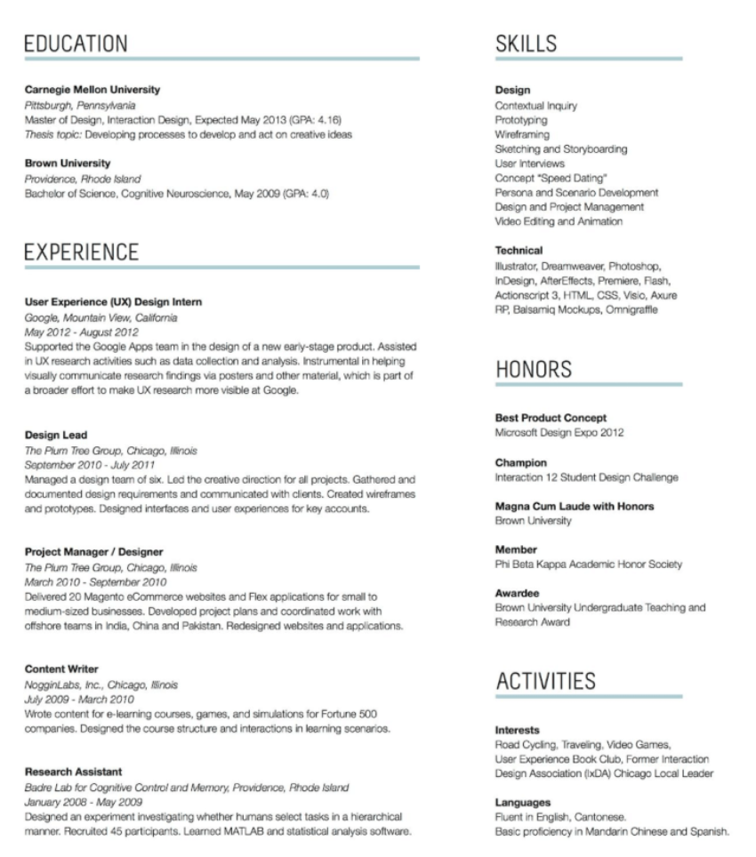
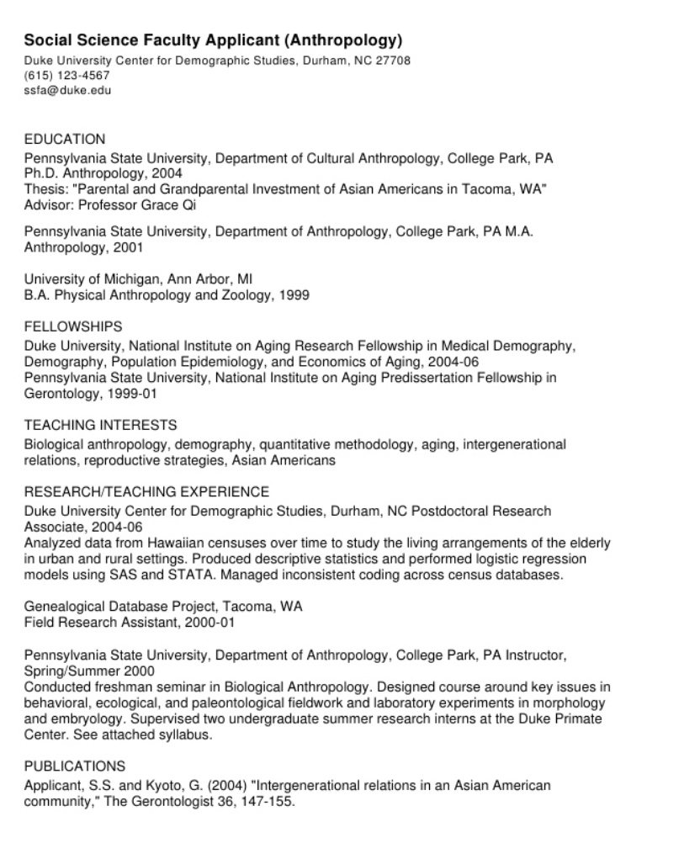
CVs Versus Skill Resumes
CVs are bad
Skill Resumes are good

Slide 35
Portfolios
Do you need a portfolio?
Technically no but it will almost always be helpful to demonstrate your abilities through example projects you’ve completed
Sometimes, your entire project is not sharable, but at least come prepared being able to explain 1-2 projects you worked on when interviewing with people.
What should be in a portfolio?
Depends on the role, but it should demonstrate work you have contributed to.
Should ultimately focus on the outcome, but you also need to show how you go there.
Common format:
Problem
Solution
Results
Use Github to post code (e.g. for software engineering or data science roles)

Slide 36
Where Do You Go From Here (First Step)
Developing Answers to Key Considerations (from earlier slide)
What role do you want to target?
What type of software product/service do you want to work with?
Where you do you want to work?
What size company do you prefer?
Network, Network, Network
Reach out to people in any position or organization you might be interested in to ask to learn about their experiences
Assess the situation
Review job postings for the type of job/company you would like.
What skills do you have / what do you lack?

Slide 37
Where Do You Go From Here (Second Step)
Address the gaps
Self-study, certifications, boot camps, a course at college... there are many ways to address the gaps and acquire the knowledge and skills you need.
Develop your Resume
Produce a skills based resume if you are a student or very early career anthropologist.
If you are a mid-career anthropologist, you may want to go with a chronological resume if the experiences are relevant, otherwise functional or skills may still be best.
Feel free to ask people you know in that industry to review your resume
Develop your Portfolio (2-3 projects)
Feel free to blog or post the code on Github to link to on applications (if possible)
Practice how you would describe what you did in an interview

Slide 38
Why Informational Interview Matters:
Learn what people do in prospective positions/industries/organizations to determine whether you would actually be happy there
Discover types of roles that could be a good fit that you never heard before
Develop connections that can lead to interviews
(Finally, good usage of ethnographic interview skills)

Slide 39
Dos & Dont’s in Informational Interviews:
Do:
Ask about their experiences
What they do now
Their story or how they got there
Their experiences at their organization(s)
Introduce who you are and what your interests are
Give a concrete explanation of your interests (not “I can do anything”)
Be honest/genuine
Valuable questions:
“Is there anyone else you’d recommend I talk with?”
“What would recommend for someone like me looking for entry level jobs in X?”
“Is there something I should be asking or thinking about but haven’t?”

Slide 40
Dos & Dont’s in Informational Interviews:
Don’t Do:
Ask questions beyond the scope of their experience or expertise
E.g. “What do you think of the data science scene in X?” where X is not where they have worked before.
Ask factual questions easily looked up
E.g. “What is the average salary for X job?”
Directly ask for a job from them
Let them bring it up if they would like to (and have an open position)

Slide 41
Additional Skills
Leadership
Interpersonal skills
Business knowledge
Domain knowledge / experience
Writing and blogging
Speaking
Design
Software (specific applications such as UserTesting, Tableau, etc)
Coding

Slide 42
Tips for Working With Other Roles
Treat working with others anthropologically: with empathy to understand their perspective and find common ground
Learn the language of other disciplines / business units.
Recognize we all come from different perspectives. Together they are generally stronger.
Focus on systems level understanding and find ways to contribute effectively.
Over communicate.
Prove your value by following through on small wins.
Respect the contributions of others to promote respect for yours.

Slide 43
Additional Resources
2012 Forbes article on skills-based resumes
Making your case: Creating a compelling UX portfolio
Interaction Design Foundation (UX Courses)
LinkedIn Learning (UX, Product, Software & Data Science Courses)
Bio of a Software Engineering Anthropologist
Integrating Data Science and Ethnography
Conducting Ethnographic Data Science Work

Slide 44
Breakout Session

