Slide 1
Designing Machine Learning Systems: Building Relatable Machine Learning
Stephen Paff

Slide 2
Presentation Overview
In this presentation, I will discuss ways to apply design principles to producing of machine learning systems.
But first, I will provide some basic definitions of the terms of the I will use.

Slide 3
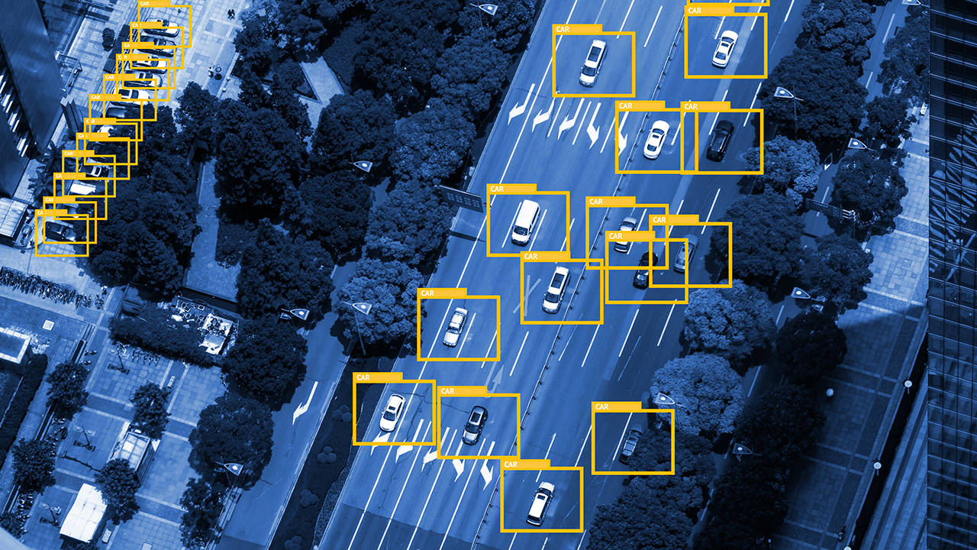
Machine Learning
Machine learning algorithms are:
Algorithmic processes which learn by developing their own ways to analyze data (in the same or new context) by adapting over iteration
Machine learning systems are:
The wider software systems that the machine learning algorithms are a part of
This is typically what users actually “interact” with when they “interact” with machine learning
https://gdmissionsystems.com/about-us/engineering/deep-learning

Slide 4
User-Centered Machine Learning Systems
In this presentation, I am focusing on user-centered machine learning systems (UCMLS):
Machine learning systems that:
Use machine learning algorithms that in some way try to predict people’s thoughts, actions, and/or preferences
Then feeds those predictions into a wider system in order to make decisions about how to respond to and/or engage with those users
Good example:
A ML recommendation algorithm that tries to predict what content a user would like next

Slide 5
Thesis
We should think of UCMLS that involve feedback loops:
Users
Data-processing (where the ML typically is)
Decision-making
In these cases, we should use design thinking to think about how to develop the best feedback system
This would have three major implications:
How to build these systems well becomes more of a design problem rather than primarily an engineering problem.
Building intentional processes for the user to interact with the system to facilitate the construction of useful mental models becomes essential.
Machine learning metrics we use should evaluate how well machine learning algorithms can produce an effective feedback system.

Slide 6
Narrative Setup
Consider the Facebook Newsfeed and how they decide which content to show to users at the top:
Eslami et al (2016) performed an interview study on how users thought the Newsfeed decided which content to show them:
They found that different users had formed several different “folk theories” or mental models of how it “decides” which posts to show on the top of their post.
Users’ interpretation of how the model worked influenced their actions on the site.
These behavioral changes might in turn influence how the data their machine learning models used to predict their behavior
Here, user behavior and the machine learning system seem to be a part of a feedback loop.
UCMLS commonly have these loops.
This is a feature not a problem.
We should design these systems to create beneficial feedback loops.

Slide 7
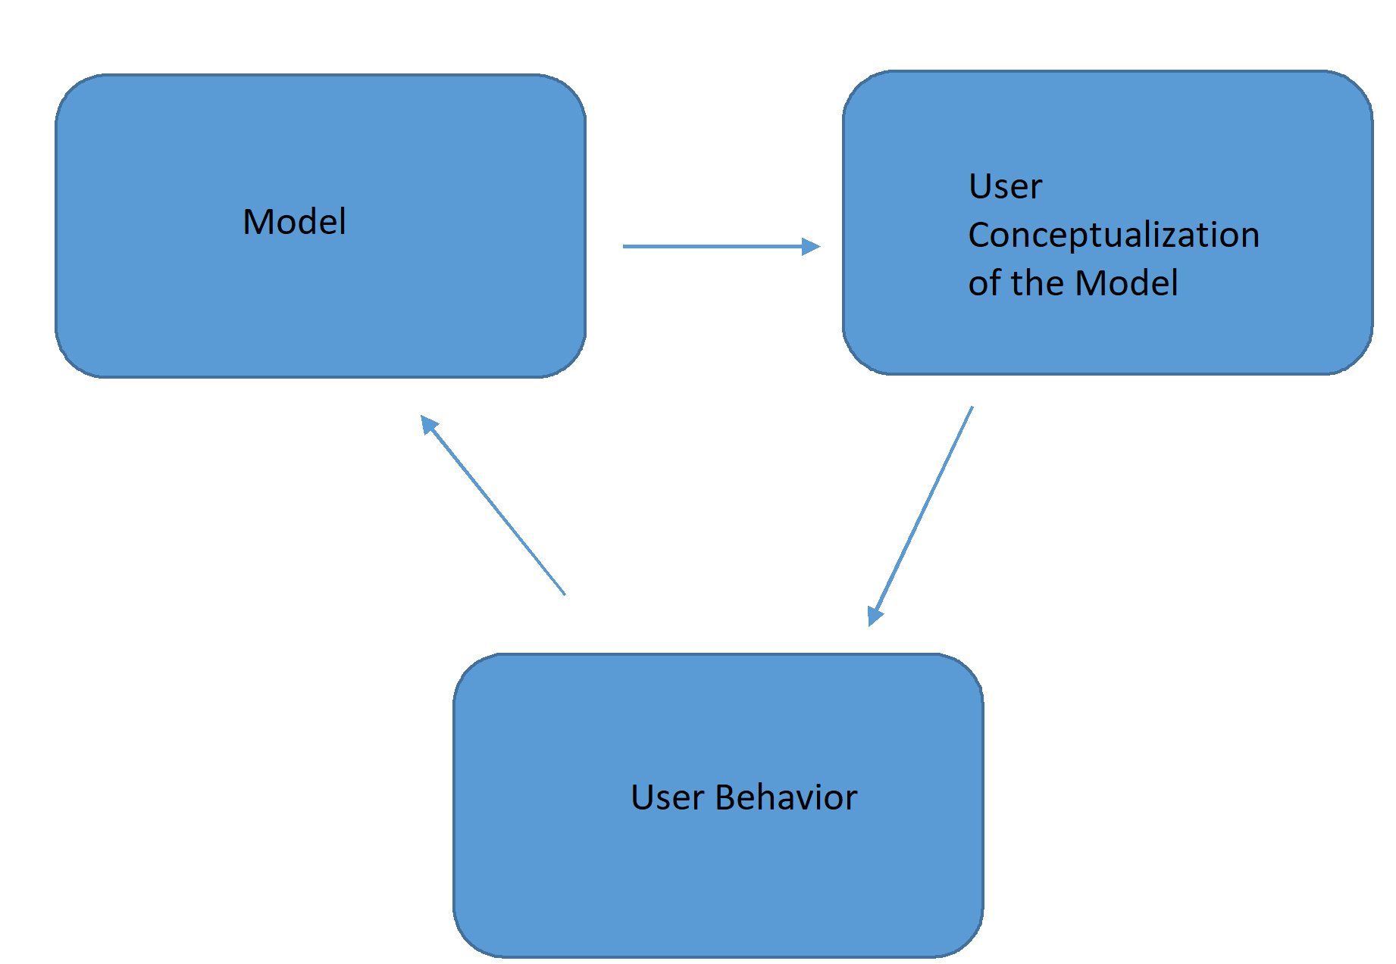
Narrative Setup
Feedback loop between:
The predictive model
User mental conceptions
User behavior
UCMLS commonly have these loops.
This is a feature not a problem.
We should design these systems to create beneficial feedback loops.

Slide 8
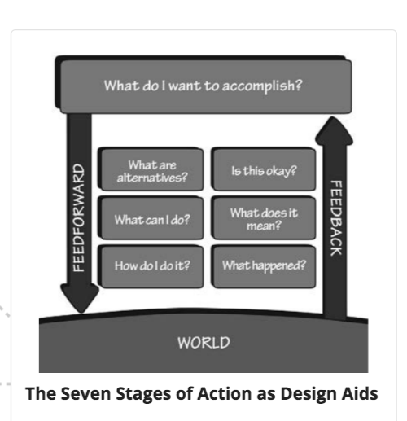
Understandability vs Mental Models
In order for people to understand anything, they must be able to develop a relationship with it.
In The Design of Everyday Things, Don Norman argues that allowing the user to construct useful mental models is most important
The usefulness of the mental model is key, not technically its accuracy
Ensuring users are able to construct and evaluate mental models of how the ML system works is crucial for relatability and thus understandability.
https://sherry-lin.medium.com/key-takeaways-the-design-of-everyday-things-chapter-2-bf24ec3c6949

Slide 9
Relatability to Construct Mental Models
We should build in ways for users to interact with and thus form a relationship with the UCMLS:
This would facilitate the process of forming mental models with how the ML systems work.
This can also provide venues for users to evaluate the system and determine proper responses to it.
To do that, we should make sure they are discoverable and provides effective feedback.
Discoverability: Information to help the user discover what is possible for that entity
Feedback: Information to help the user process what has happened
Many consider ML a black box.
One major factor is the internal mechanisms that make it up are hard to decipher
But also in large part because they do not have effective mechanisms to form mental models of how the algorithm works.

Slide 10
Potential Examples of How to Do This:
Show multiple layers of output for users to compare with each other
Include an “incognito space” for users to explore on their own
Give users options for which data to include to train the machine learning models
Provide users the effects of their behavior on the predictions about the user
Allows users to provide feedback into the prediction results that influence how the models make future predictions for that user

Slide 11
Case Study: No Show Product
For a hospital, I built a UCMLS for a clinic to help schedulers understand how appointments would occur on a given day for any doctor working that day.
In order to develop this, I intentionally constructed a feedback system to allow the schedulers to interrogate the system to explore/analyze why it made the predictions it did.
I did this by constructing two models:
Model 1: Predicted the probability the given appointment would occur
Model 2: Predicted the number of appointments likely to occur on a given doctor’s shift
This allowed schedulers to construct a mental model of how the system made its predictions.
https://unsplash.com/photos/nMyM7fxpokE

Slide 12
Systematic not Predictive Metrics
In data science, most metrics seek to evaluate the predictive performance of ML models.
For UCMLS, we should also construct metrics to evaluate how well the model:
Performs effectively in the feedback loops between them, the user, and the other aspects of the system
Enables the users to construct these mental models
Design thinking, anthropology, and cybernetics could be useful in developing these new metrics.

Slide 13
Conclusion
UCMLS are complex, integrative feedback systems between the users, data-processing, and decision-making.
Building all aspects of this system ML algorithms (common decision-makers in these systems) is a complex design question.
Not a technical matter of refining predictive capacity
To approach them this way, opens up new space for building relatable machine learning and innovate products.

Slide 14
Sources Mentioned
Eslami, Motahhare, et al. "First I “like” it, then I hide it: Folk Theories of Social Feeds." Curation and Algorithms (2016).
Norman, Donald A. The Design of Everyday Things. New York: Doubleday, 1990.

